Slide 1
Project: 2018 Data Challenges Sponsored by Teradata University Network
Capstone Class Project for Jeff Mills
Summer 2018
Kansas State University

Slide 2
Overview
Problem:
The National Multiple Sclerosis Society (NMSS) Bike MS events are struggling to maintain fundraising and participation
Bike MS participation and revenue have steadily declined since peaking in 2012.
NMSS attributes this to increased competition for charity monies and time.
Bike MS currently loses past participants faster than it recruits new ones.
NMSS believes it must increase new cyclist participation to have future success.
NMSS believes it must also recruit new 10+ member corporate teams to maximize fundraising.
According to NMSS,
10+ members teams raise 3x money of smaller teams
over 41% of the 1,561 teams with 10+ members in 2017 were corporate teams
NMSS goals for 2018 Bike MS:
Increase from 74,000 riders to 80,572 riders (8.88%),
Increase from 6,150 teams to 6,489 teams (5.51%),
Recruit 40,000 new riders,
Increase number of corporate teams with 10 or more riders,
Successfully utilize digital marketing efforts to impact fundraising goals.

Slide 3
Research Priorities
FIRST PRIORITY: CORPORATE ACQUISITION
What are the greatest growth opportunities for new corporate teams?
Can we apply those opportunities to specific rides/markets, especially our biggest events?
What industries have had the strongest involvement in Bike MS in the last five years?
What occupations were responsible for most of our fundraising?
Can we tie together these industries and occupations to identify gaps/opportunities?
What is the common denominator for our top performing corporate teams? (Is it industry, culture, executive involvement, connection to MS, other?)
Can we quantify the effect competing events are having in our top markets?

Slide 4
Research Priorities
SECOND PRIORITY: DIGITAL/SOCIAL ACQUISITION
What are the greatest opportunities for digital marketing investments? Where have we seen the greatest ROI?
Once someone is registered, what tactics and behaviors drive fundraising, and at what times leading up to the event?
What behavioral data do you see about usage of our fundraising tools and how it may or may not relate to performance of top fundraisers?
Despite increasing our digital advertising spend, acquisition continues to trend downward overall. Why? Is it an issue of needing more traffic, better targeting, or a conversion rate issue that needs to be addressed through the registration process? What can we do to reverse the trend?
FINALLY:
As you studied this data, is there something else that came up as an insight into our operations that the questions above do not capture?

Slide 5
Data
Donations 2013-2017 Bike Donations.csv
Events 2013-2017 Bike Events.csv
Participants 2013-2017 Bike MS Participants.csv
Bike Teams 2013-2017 Bike Teams.csv
National Teams 2013-2017 National Team Activity.xlsx
Affiliates Contains Affiliate_Codes.xlsx
Bike MS Digital Advertising Reports Advertising reports for the 2015-2018 fiscal years.
Google Analytics Google Analytics report for the National MS Society website.

Slide 6
National Bike Teams - Initial Model
y = 'Revenue Raised'
F(x) = Number of Team Members (local)", 'Event Month’, 'Event Year’, 'Relative has MS’, 'None’, 'No Connection’, 'Has MS’, 'Parent has MS’, 'Spouse has MS’, 'Child has MS’, 'Sibling has MS','TX', 'PA', 'NJ’, 'CA', 'MN', 'NY', 'FL', 'MA', 'IL', 'MI', 'OH', 'NC', 'WA', 'CO', 'MO', 'UT', 'MD', 'VA', 'CT', 'AZ', 'GA', 'WI', 'KY', 'KS', 'TN', 'AL', 'AR', 'DE', 'NH', 'DC', 'IN', 'OK', 'IA', 'AK’, 'RI', 'RI', 'NM', 'NE’, 'NV', 'OR', 'MS', 'SD', 'WV', 'LA', 'ME', 'SC’, ‘MT’, and a constant
Left out 'Other' for connection to MS, and 'ND' for state to account for dummy trap

Slide 7
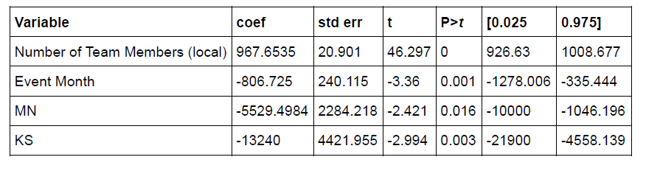
National Bike Teams - Initial Model
OLS Regression Results
Adj. R-squared: 0.709
Following variables were significant at the 95% level.

Slide 8
National Bike Teams - Initial Model
OLS Regression Results
Adj. R-squared: 0.709
Following variables were significant at the 95% level.

Slide 9
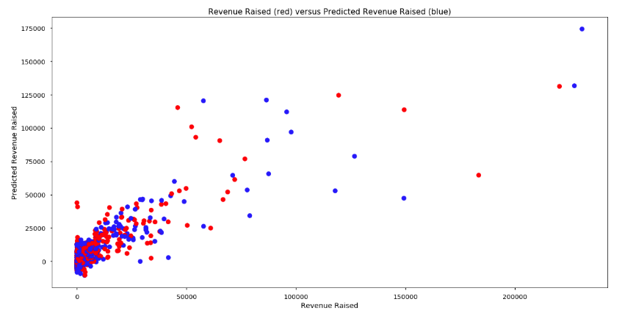
National Bike Teams - Initial Model

Slide 10
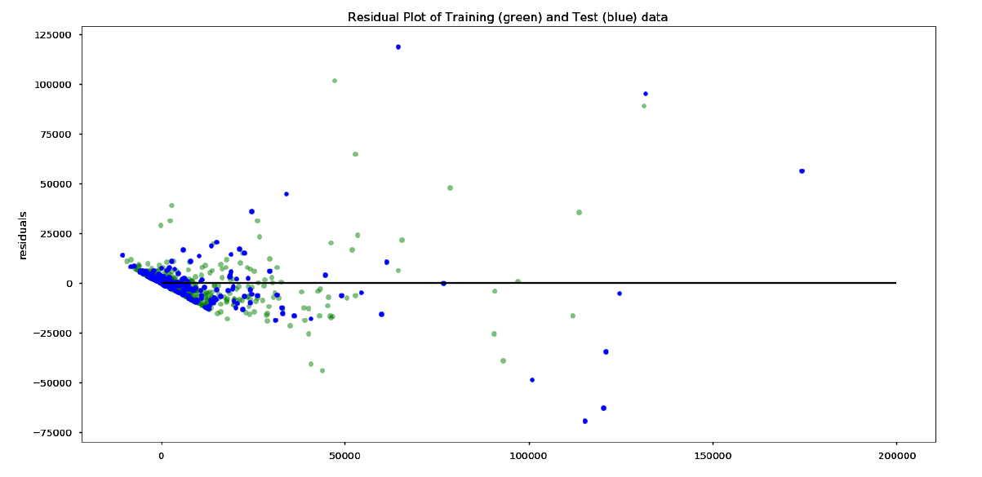
National Bike Teams - Initial Model

Slide 11
National Bike Teams - Initial Model
Adjustments to the Model
Residuals show evidence of Heteroskedasticity.
Likely due to large range between the max and min gift amounts.
Probable the error variance changes proportionally with a factor.
To adjust:
Dependent redefined as 'Revenue Raised' divided by 'Number of Team Members (local)' to reduce impact of differences in revenue amounts.
Sixty-Three 'Number of Team Members (local)' were equal to blank.
All had positive revenues raised,
Replaced with the average team size (12).

Slide 12
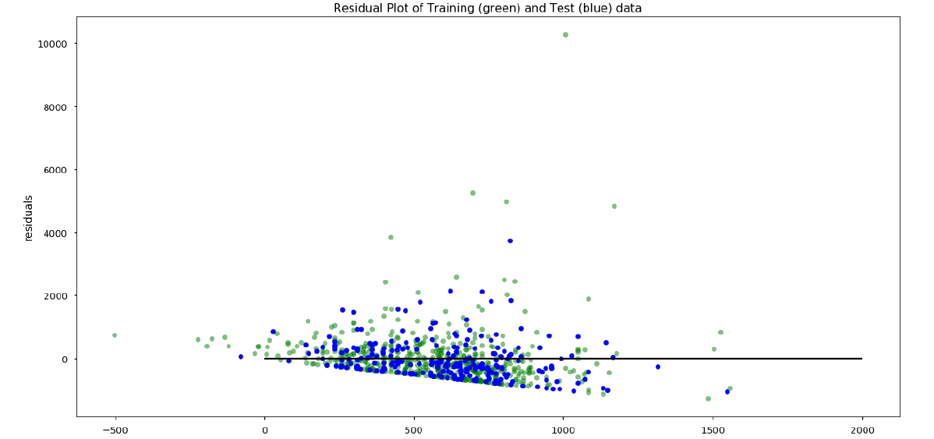
National Bike Teams - Revised Model
R-squared: 0.063
R-squared: -0.007

Slide 13
National Bike Teams - Revised Model
Further Adjustments:
It appears the 11,289 per member is an issue with Heteroskedasticity and predictions, but are the other teams outliers?
Observation is an outlier if it falls more than 1.5(IQR) above the upper quartile or more than 1.5(IQR) below the lower quartile.
Revenue Raised per Team Member: 25% = 123.125000, 75% = 728.250000
IQR = Q3 − Q1 = 728.25 − 123.125 = 605.125
1.5(IQR) = 1.5(605.125) = 907.6875
Q1 − 907.6875 = 123.125 - 907.6875 = −784.5625. No outliers in the bottom of the distribution.
Q3 + 907.6875 = 728.25 + 907.6875 = 1,635.9375.
Max is 11,289, There are outliers in the top of the distribution.
All Revenues Raised per Local Team member in excess of 1,635.9375 eliminated

Slide 14
National Bike Teams - Revised Model
R-squared: 0.124
Adj. R-squared: 0.054
Clearly number of team members is a major explainer of Revenue Raised, so it needs to be restored to independent variables.
Outliers for Revenue Raised
IQR = Q3 − Q1 = 6713.75 − 346.25 = 6367.5
1.5(IQR) = 1.5(6367.5) = 9551.25
Q1 − 9551.25 = 346.25 - 9551.25 = −9205. The minimum value is 0 so there are no outliers in the bottom of the distribution.
Q3 + 9551.25 = 6713.75 + 9551.25 = 16,265. The maximum value is 230589.24 so there are outliers in the top of the distribution.
All Revenues Raised in excess of 16,265 will be eliminated from the forecast.

Slide 15
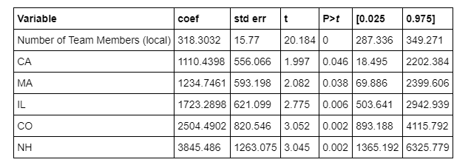
National Bike Teams - Revised Model
OLS Regression Results
Adj. R-squared: 0.406
Following variables were significant at the 95% level.

Slide 16
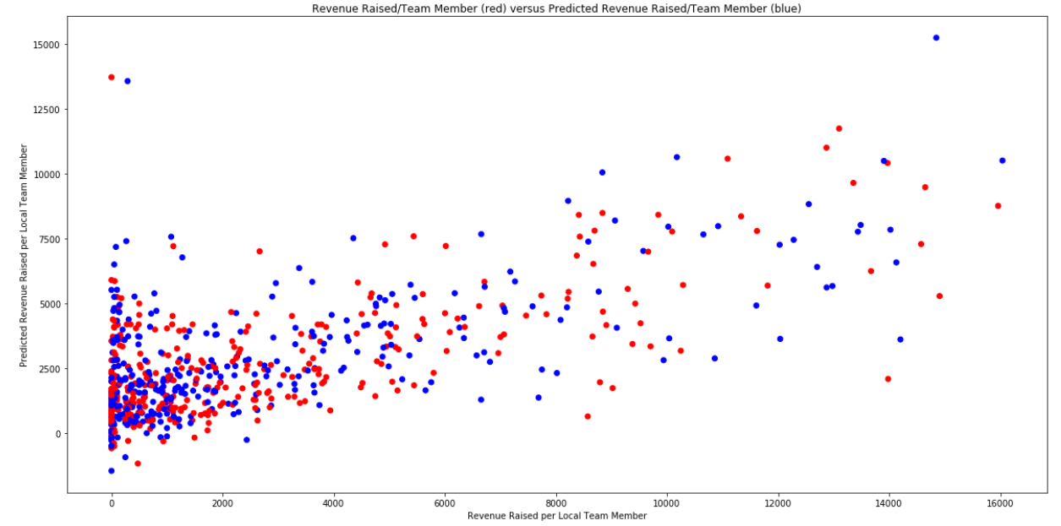
National Bike Teams - Revised Model
R-squared: 0.455
Adj. R-squared: 0.406

Slide 17
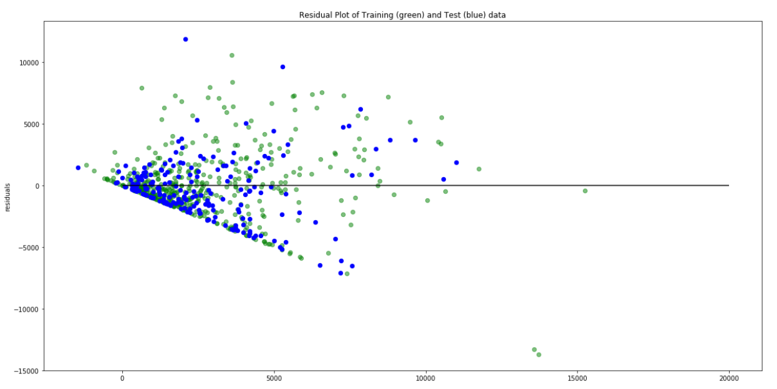
National Bike Teams - Revised Model
R-squared: 0.455
Adj. R-squared: 0.406

Slide 18
Bike Teams - Initial Model
y = 'Team Total Confirmed ($)'
X = 'Number of Participants’, 'Total Fees Paid’, 'Total Online Gifts($)’, 'Total Offline Confirmed Gifts($)’, 'Team Goal($)’, 'Total Confirmed Gifts in Team History($)’, 'Previous Event Fiscal Year’, 'Fiscal Year’, 'Association’, 'Beer/Brewery’, 'Bike Club’, 'Bike Shop’, 'Corporate’, 'Family and Friends’, 'Open’, ’Org Groups’, 'Other’, 'School', 'Small Business’ plus a constant
#Left out 'Ohana' for team division, 'Total Offline Confirmed Gifts($)’, 'Total Offline Unconfirmed Gifts($)', to account for dummy trap

Slide 19
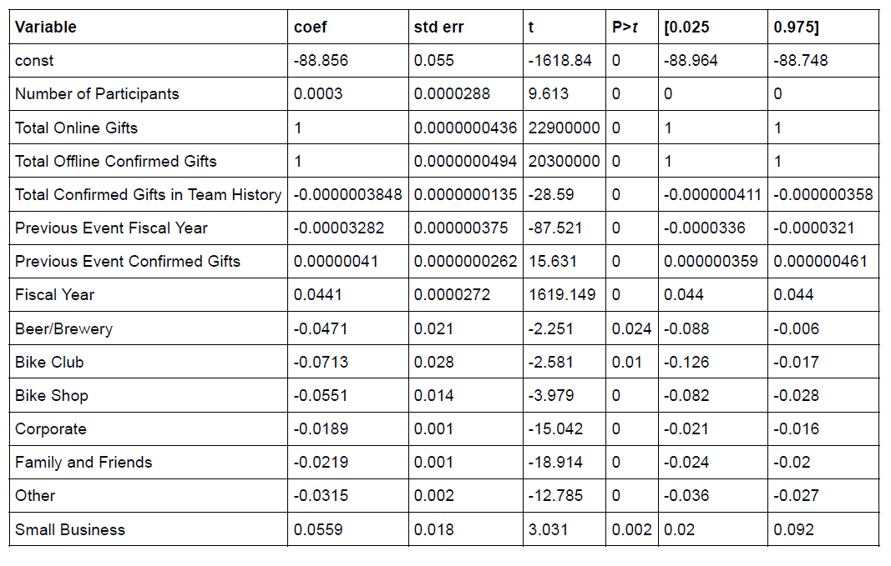
Bike Teams - Initial Model (rerun and drop total offline confirmed gifts and rerun)
OLS Regression Results
Adj. R-squared: 0.953
Following variables were significant at the 95% level.

Slide 20
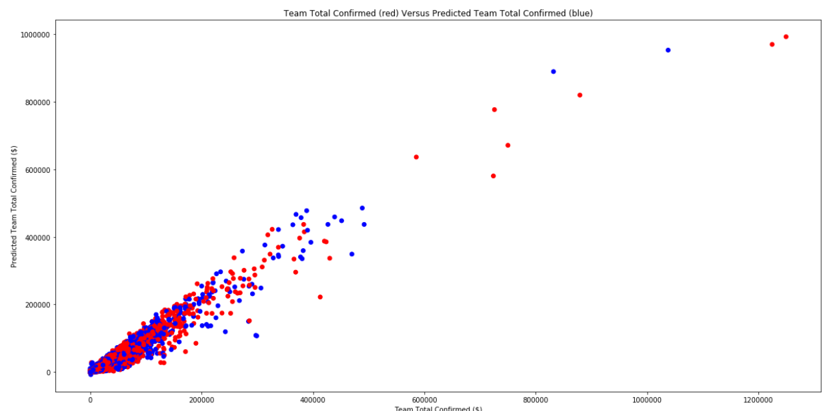
Bike Teams - Initial Model
Add chart

Slide 21
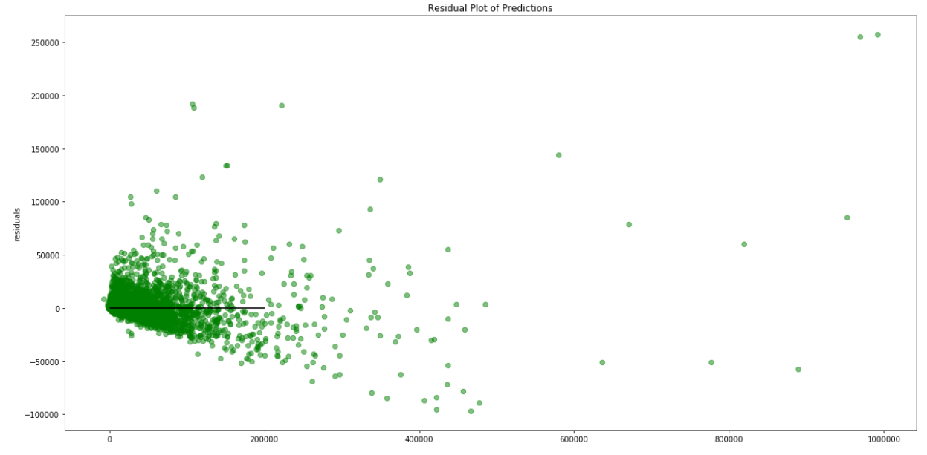
Bike Teams - Initial Model Residuals
Add chart

Slide 22
Events- Initial Model
y = 'Total of All Confirmed Gifts($)'
X = 'Event Month', 'Event Year’, 'Active Registrations’, 'Teams’, 'Average Team Size', 'AK', 'AL’, 'AR', 'AZ', 'CA', 'CO', 'CT', 'DC', 'DE', 'FL', 'GA', 'HI', 'IA', 'ID', 'IL', 'IN', 'KS', 'KY', 'LA', 'MA', 'MD', 'ME', 'MI', 'MN', 'MO', 'MS', 'MT', 'NC', 'NE', 'NH', 'NJ', 'NM', 'NM','None', 'NY', 'OH', 'NV’, ‘MT’, ‘WY’, OK', 'OR', 'PA', 'RI', 'SD', 'TN', 'TX', 'UT','Emails Sent’ plus a constant
Left out 'ND' for state, 'Event Day', 'Fiscal Year', 'Inactive Registrations', "Event Goal($)", 'Total Fees Paid', and ’Total Online Gifts($)', to account for dummy trap

Slide 23
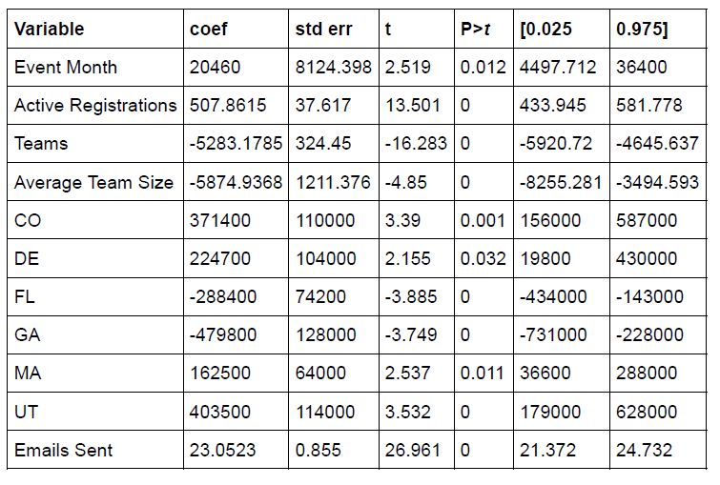
Events- Initial Model
R-squared: 0.982
Adj. R-squared: 0.980
Following variables were significant at the 95% level.

Slide 24
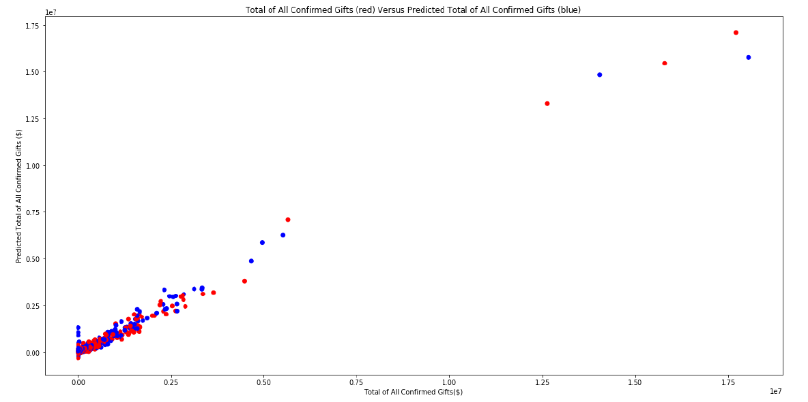
Events- Initial Model

Slide 25
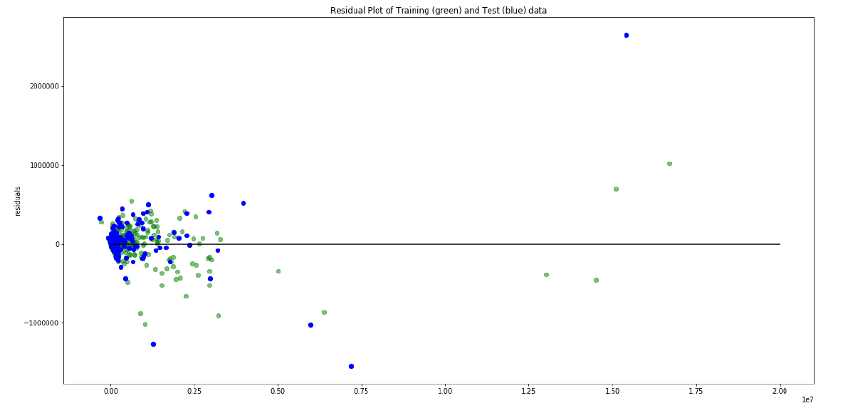
Events- Initial Model

Slide 26
Participants- Initial Model
y = 'Total of All Confirmed Gifts($)'
X = ‘Total From Participant($)’, "Total Not From Participant($)", 'Event Month’, 'Event Year’, 'Healthcare’, 'Engineering’, ’Information Technology (IT)’, ’Sales’, 'Executive/Management’, 'Education and Training’, 'Consulting’, 'Banking and Financial Services’, 'Accounting’, 'Legal and Paralegal’, 'Marketing’, 'Construction and Landscaping’, 'Real Estate, Rental, and Leasing’, 'Administrative, Support, and Clerical’, 'Science and Biotechnology’, 'Government’, ‘Insurance’, 'Manufacturing’, 'Retail/Wholesale’, 'Skilled Work and Trades’, 'Nonprofit’, 'Fire, Law Enforcement, and Security’, 'Human Resources’, 'Transportation and Warehousing’, 'Restaurant and Food Services’, 'Arts and Entertainment’, 'Homemaking’, 'Hotel, Gaming, Leisure, and Travel’, 'Media’, 'Architecture’, 'Environment’, 'Facilities, Maintenance, and Repair’, 'Telecommunications’, 'Oil and Gas’, 'Military’, 'Advertising’, 'Personal Care and Service’, 'Aviation and Airlines’, 'Aerospace and Defense’, 'Stock Broker/Investment Advisor’, 'Property Management’, 'Social Work’, 'Clergy’, 'Psychology’, 'Agriculture, Forestry, and Fishing’, 'Photography’, 'Publishing’, 'Technical Account Manager’, 'Retired’, 'Relative has MS’, 'None’, 'I have MS’, 'Parent has MS’, 'Spouse has MS’, 'Child has MS’, 'Sibling has MS’, 'TX', 'PA', 'NJ', 'CA','MN', 'NY', 'FL', 'MA', 'IL', 'MI', 'OH', 'NC', 'WA', 'CO', 'MO', 'UT', 'MD', 'VA', 'CT', 'AZ', 'GA', 'WI', 'KY', 'KS', 'TN', 'AL', 'AR', 'DE', 'NH', 'DC', 'IN', 'OK', 'IA', 'AK', 'RI', 'RI', 'NM', 'NE', 'NV', 'OR', 'MS', 'SD', 'WV', 'LA', 'ME', 'SC’, 'MT’, 'Family and Friends’, 'Corporate’, 'Organization (Clubs; Civic Groups; Place of Worship; etc.)’, 'Female’ plus a constant
#Left out 'Male' for gender, 'Student' for occupation, 'Other' for connection to MS, 'Other' for occupation, 'School' for team division, and 'ND' for state to account for dummy trap

Slide 27
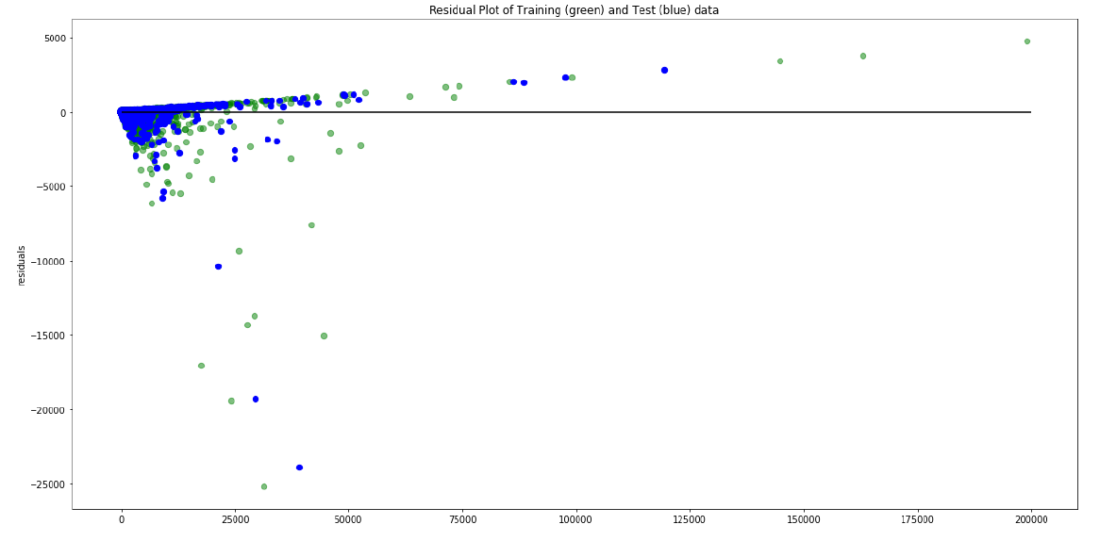
Participants- Initial Model
R-squared: 0.989
Adj. R-squared: 0.989
BUT!!!!!!

Slide 28
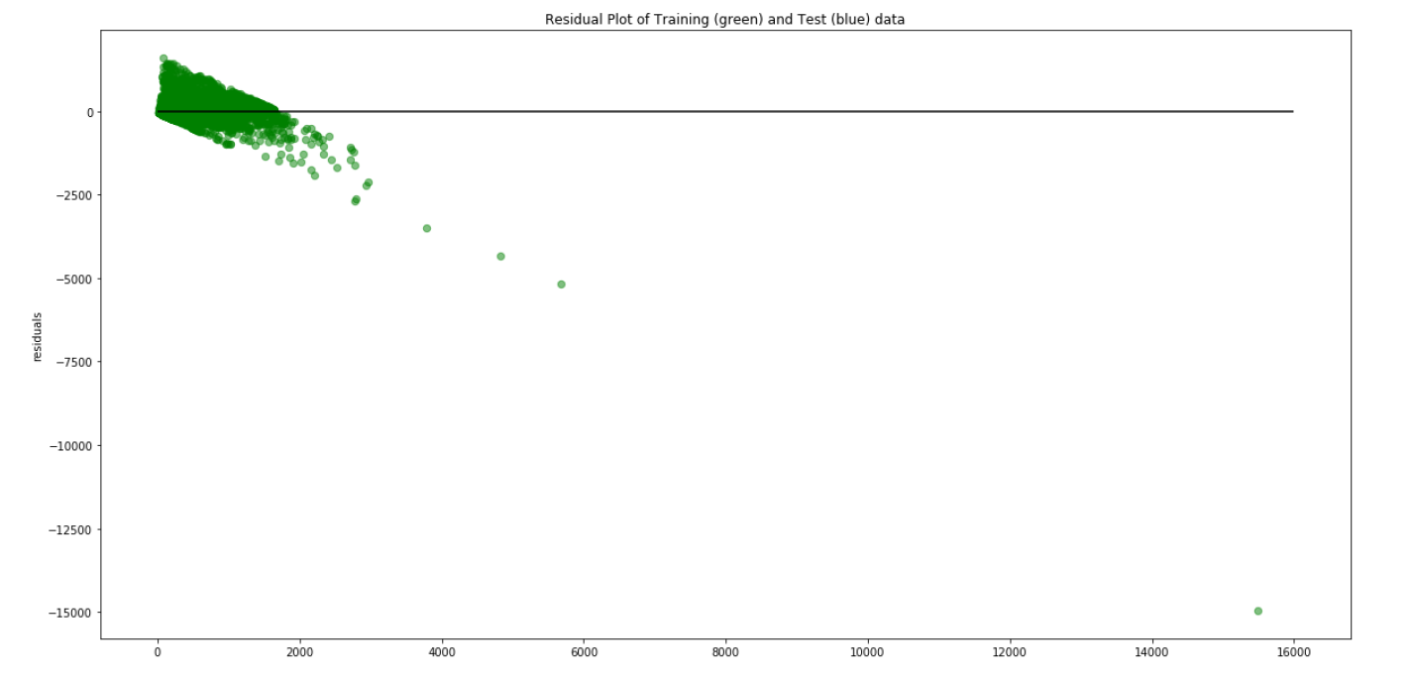
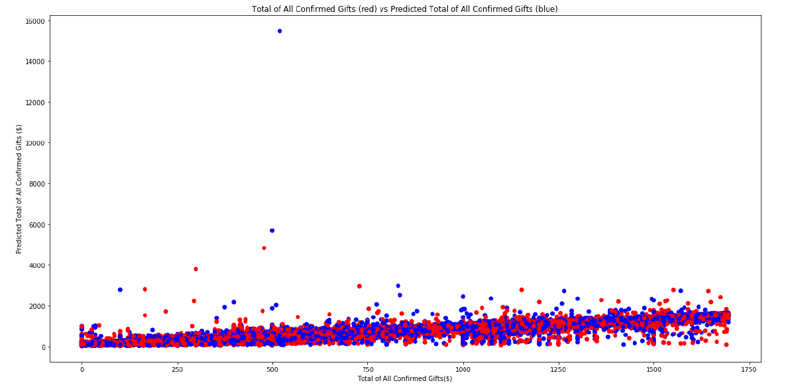


Participants- Revisions
Heteroskedasticity in residuals
Outliers
No outliers in the bottom of the distribution.
Total of All Confirmed Gifts-in-excess-of-1,700-will-be-eliminated-from-the-forecast.“
Revision Model had massive overestimation

Slide 29
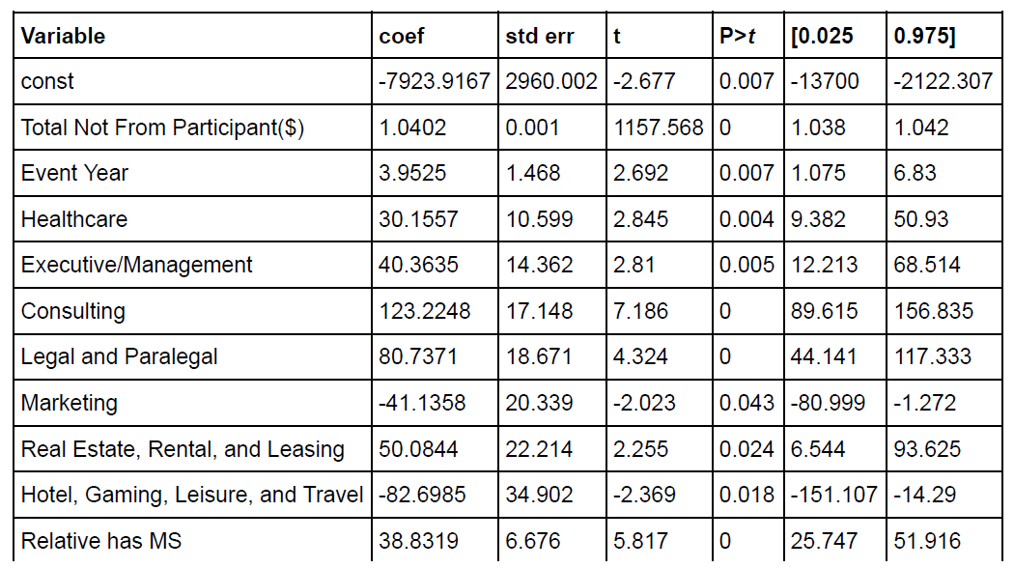
Participants- Revisions Part 2
Residuals shape show multiple linear lines with negative slope.
Raw data examination exposed 2,706 observations where the Total Not From Participant exceeded the Total of All Confirmed Gifts.
These occurrences will be dropped and the 2nd model run again.
These adjustments yielded Adjusted R^2 of 0.957.

Slide 30
Participants- Revisions Part 2
The following variables were significant at the 95% level

Slide 31
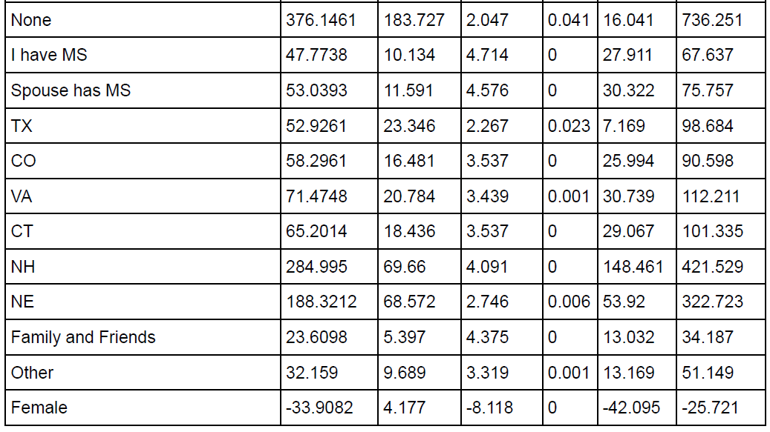
Participants- Revisions Part 2
Significant at the 95% level Cont

Slide 32
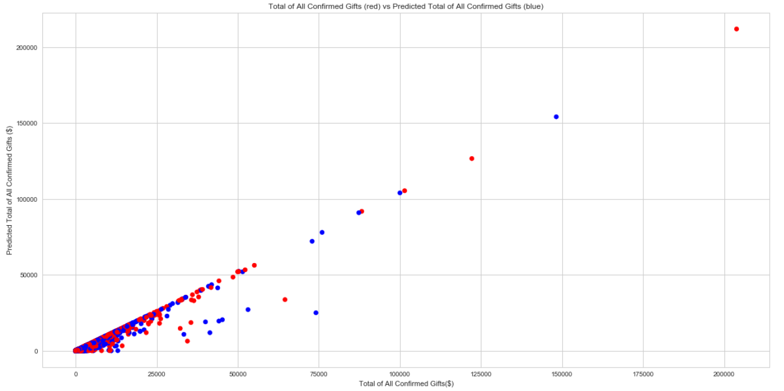
Participants- Revisions Part 2

Slide 33
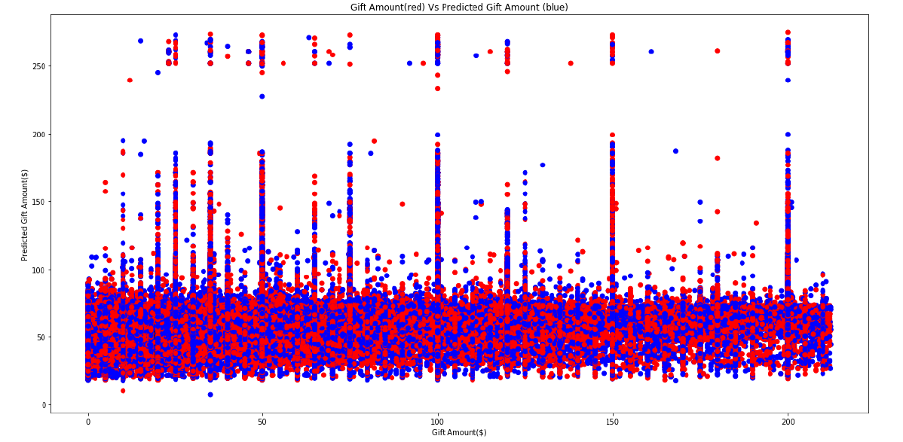
Donations

Slide 34
Donations
The residuals shape shows multiple horizontal lines with a positive slope.
Scatter plot of actual and predicted gift amounts, the pattern of multiple vertical lines at multiple gift value points is obvious.
Likely instances of donors giving set amounts, or constant values regardless of the independent variables.
Further investigation: Gifts in the data are given as online or offline.
The answer is that people do give the fixed amounts observed both offline and online. For both, the 25% quartile was 25, the 50% quartile was 50, and the 75% quartile was 100.
Perhaps the way forward would be to group gifts into gift amount buckets and attempted to identify those donors most associated with each bucket.
Less than 25 (0+(gift amount/25))
25 to 50 (1+(gift amount/50))
51 to 100 (2+(gift amount/100))
Over 100 (3+(gift amount/150000))
150,000 was used to index the last bucket since the max gift was 149,170
This calculation should both help identify buckets but also have a weight to indicate if a donor is more likely to give 25 or 50 than a simple '1' would provide.
Modifications made to raw data to calculate index.

Slide 35
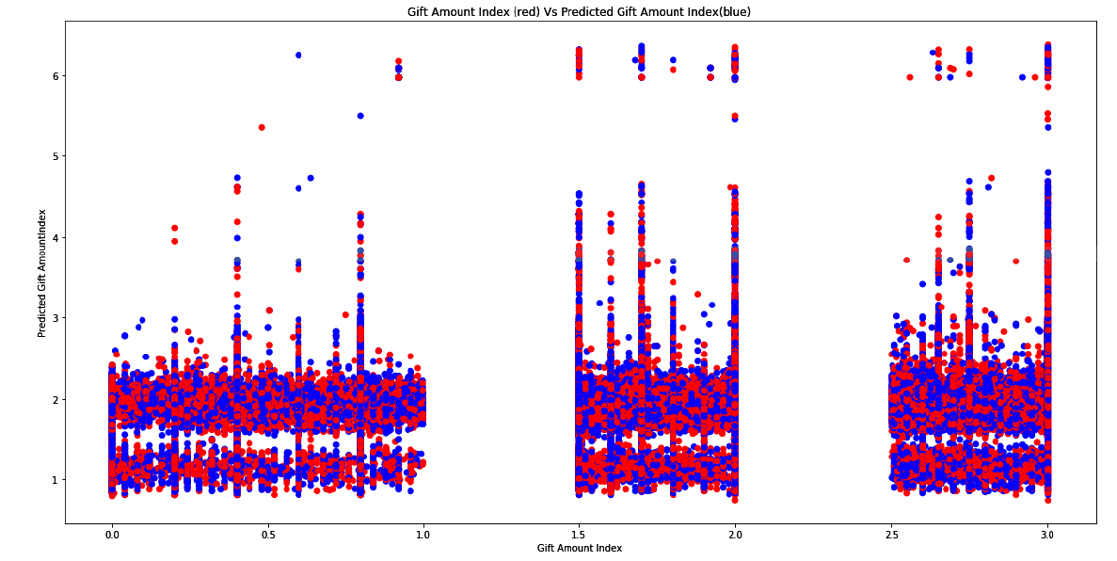
Donations

Slide 36
Donations
Managed to isolate the lump sums donors give, but with an r^2 below 5%, there is very little explained by the.
Model No Longer Pursued
Given the results of the donors data and the donors relevance only to the "FINALLY: As you studied this data, is there something else that came up as an insight into our operations that the questions above do not capture?" of the project, there is little gained by evaluating this model further.

Slide 37
Thank You
Jeff Mills
https://github.com/mills-jeffreyb/GENBA894

